Slide 1

AAB Consulting Miami
Management Team:
Bryan LaSane, Developer, Marketing and Client Engagement
Andrew Hidalgo, Back End Developer, Marketing
Andrew McCoy, Front End and Back End Developer

Slide 2



The Challenge
The Client
Erick David, Des Moines Metropolitan Area, Iowa
Talk Show Radio Host
Weekly show content perpetration
In-show research
Generate Revenue
Social Media Content

Slide 3

Technologies Used
User Interface
Streamlit
Content Gathering & Analyzation
APIs
Flair
Google Text to Speech
Revenue Generation
Solidity
REMIX
Ganache
MetaMask
Wombo.Art
Backend Functionality
Shutil
Selenium / Helium
Glob

Slide 4
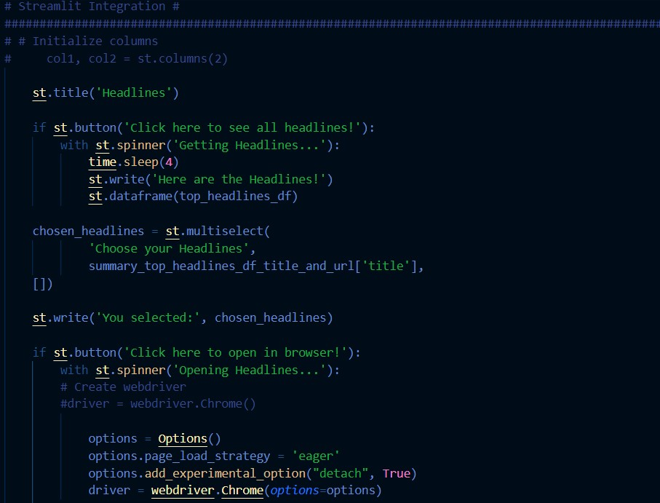
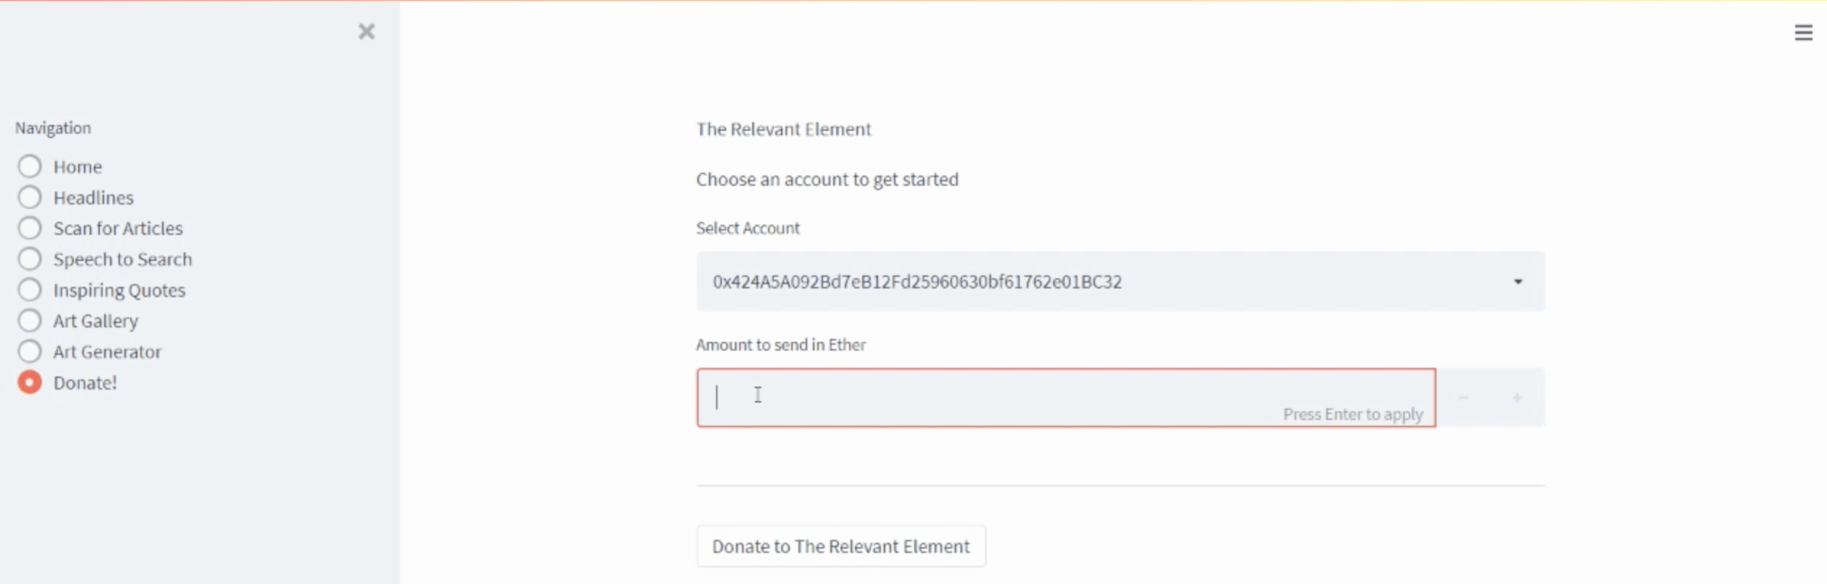
Streamlit
An open source app Python library that is used to create user-friendly webpage interfaces.
Tun Python scripts into sharable web apps.
Used to build front-end interface data gathering, content creation and revenue generation.

Slide 5
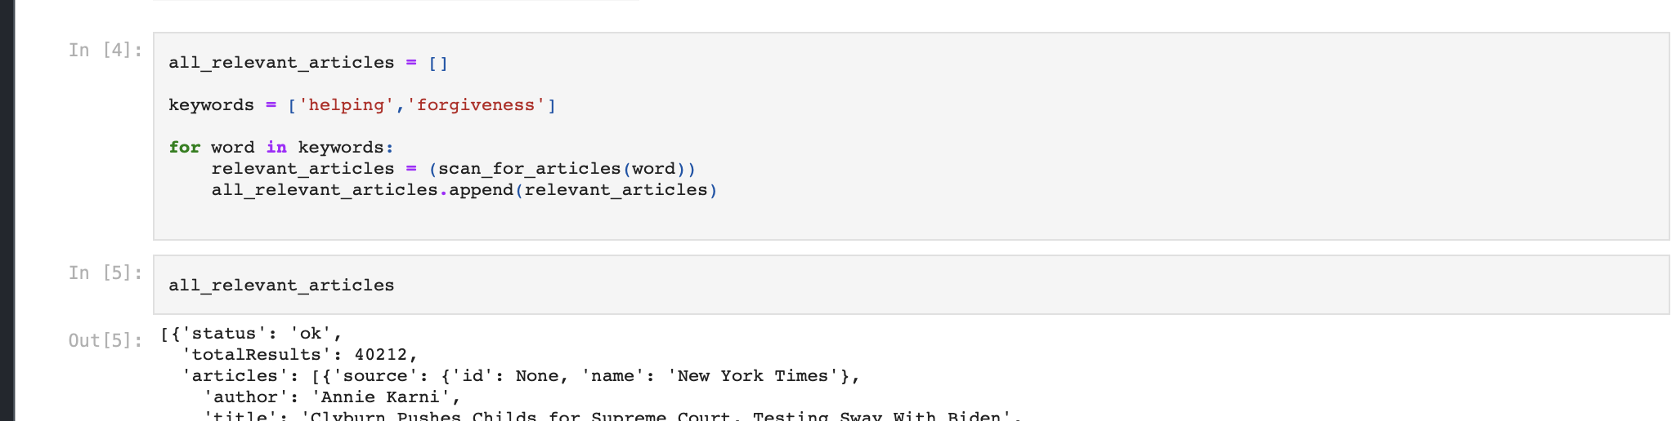
News api
Locate articles and news headlines from sources across the web.
Enables user to complies articles based on keywords.
Increased research effectivity.

Slide 6

PYAudio
User wants a hands free, quick search option.

Slide 7
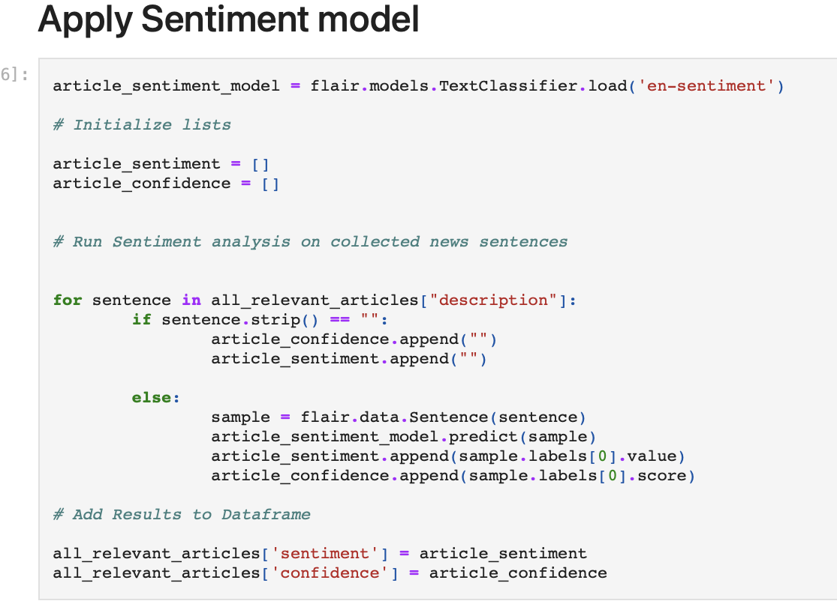
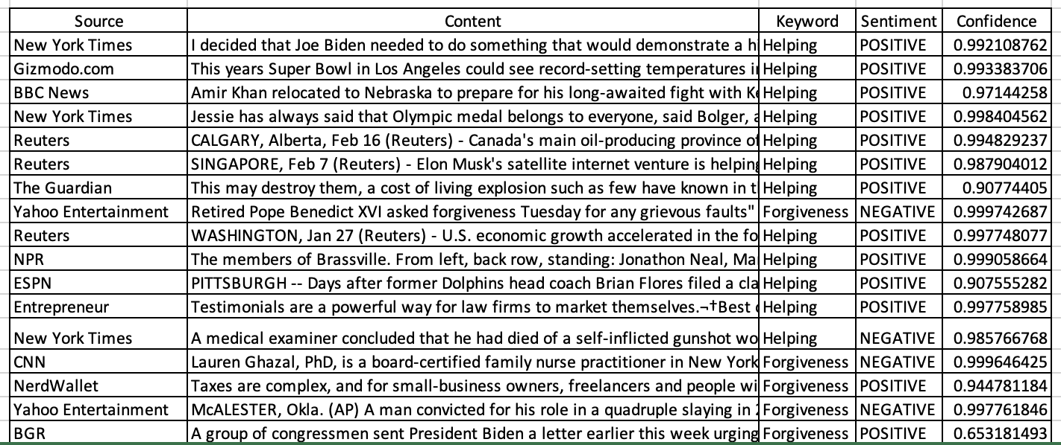
Flair
A Natural Language Processing (NLP) library.
Built for text classification.
Gives context and sentiment to articles from API
Used to decipher overall tone of article

Slide 8

Back-End Functionality
Helium
Helium is a Python library for automating websites.
Shutil
high-level operation on a file like a copy, create, and remote operation on the file.
Global (Glob)
File navigation

Slide 9
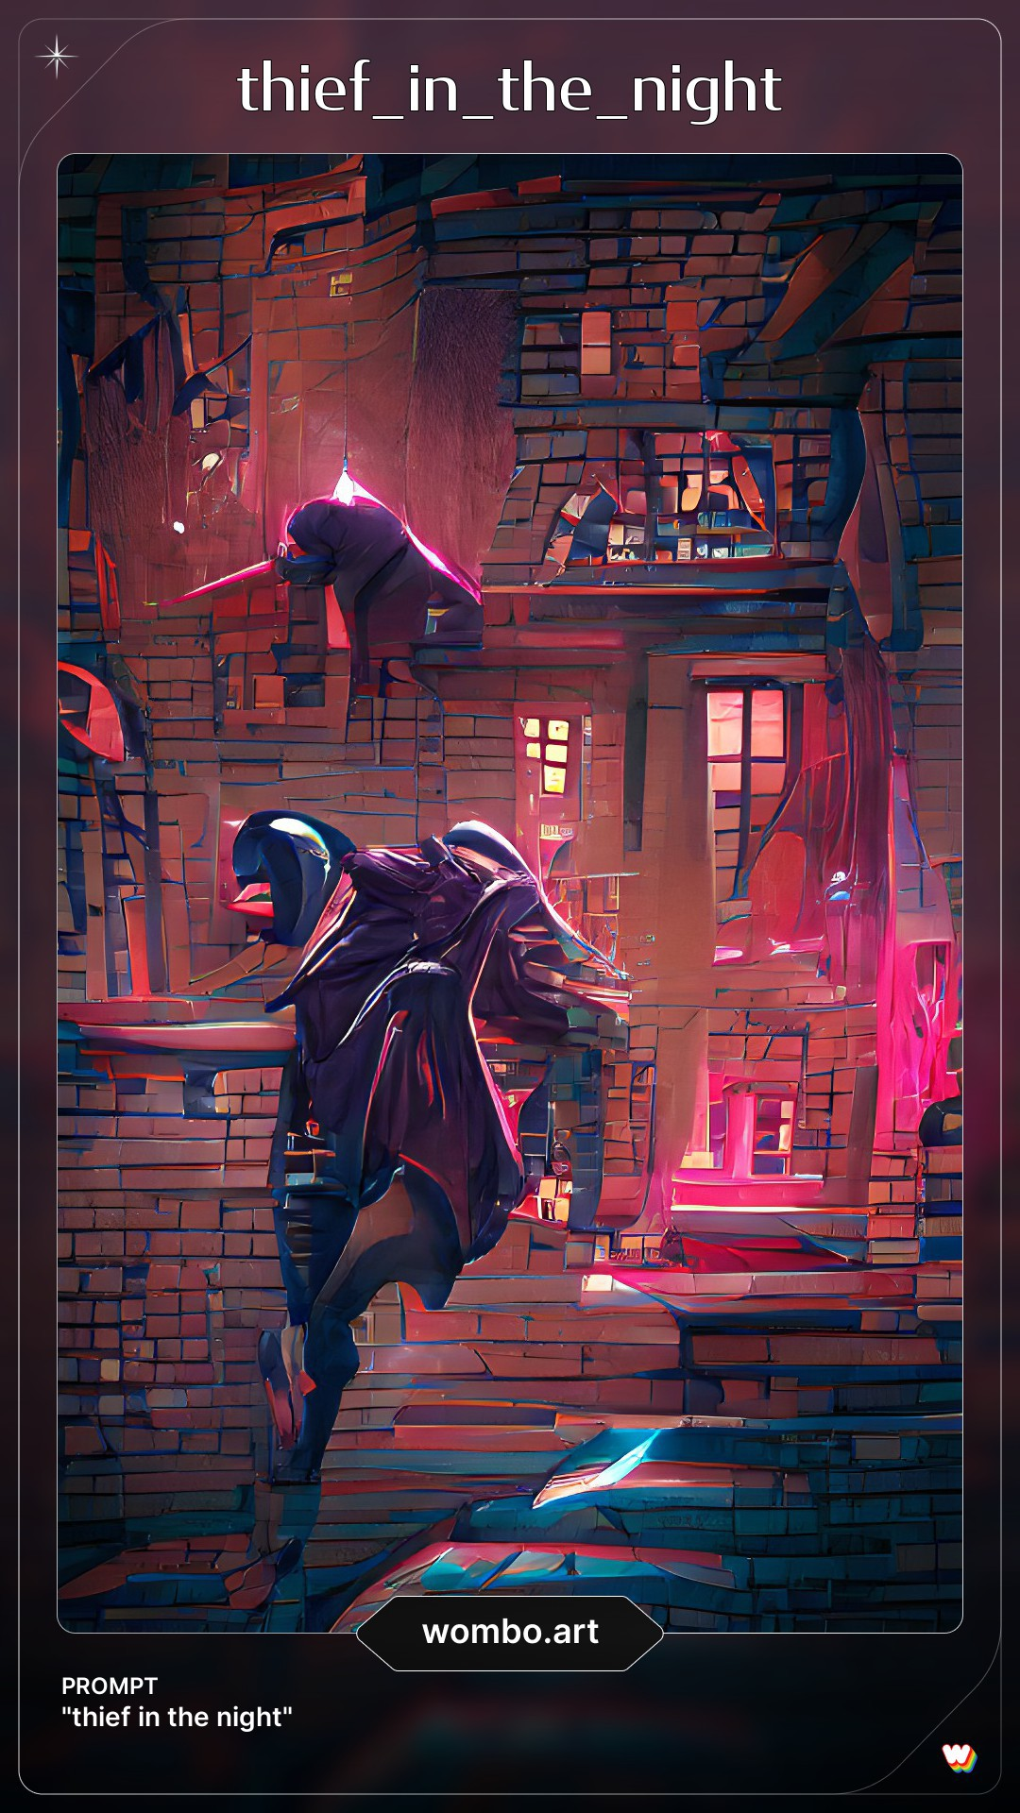
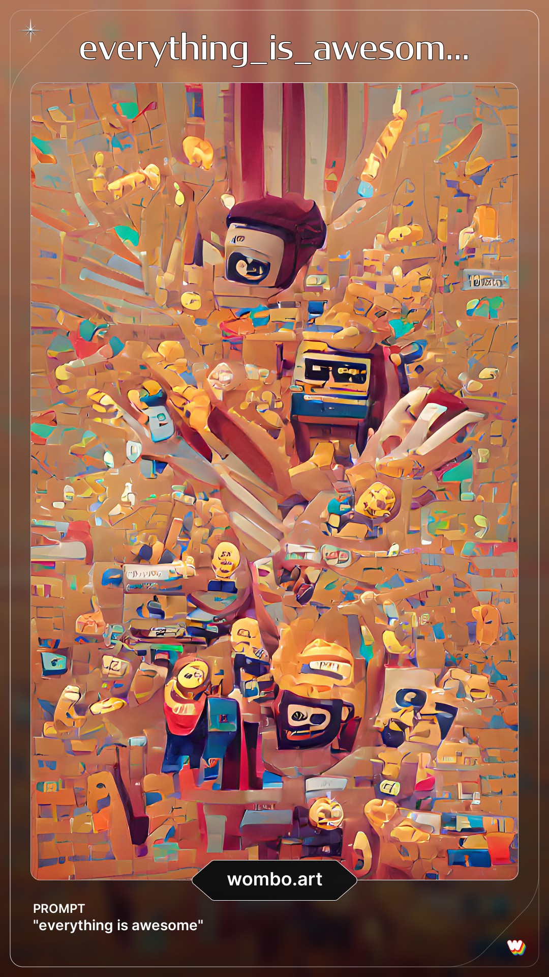
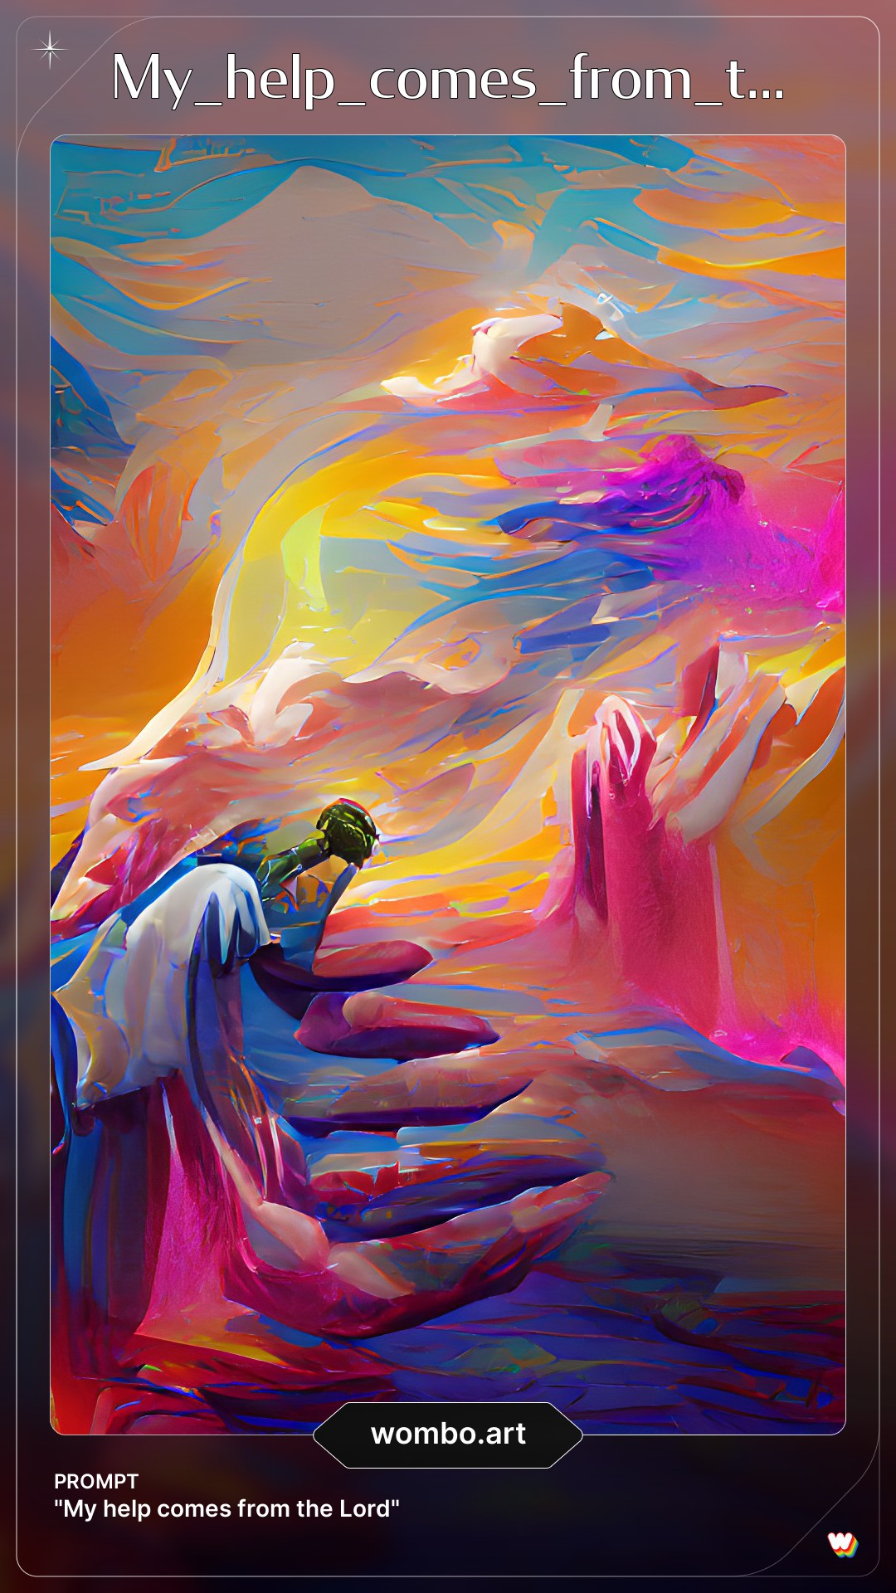
Wombo.Art
An image manipulation AI technology.
Combine word prompts with an art style to create beautiful and completely original paintings in a matter of seconds.
Originally created to make selfies sing.
Social media content creation

Slide 10

REVENUE GENEORATOR
METAMASK
Digital Wallet
REMIX
allows developing, deploying and administering smart contracts for Ethereum
Solidity
Programming language for implementing smart contracts. Smart contracts are programs which govern the behavior of accounts.

